Slide 1

Al-Usra Hajj and Umrah Company Management System
Database Project Presentation
Prepared by: Mohammed Jaber & Hiba Bani Meneh

Slide 2
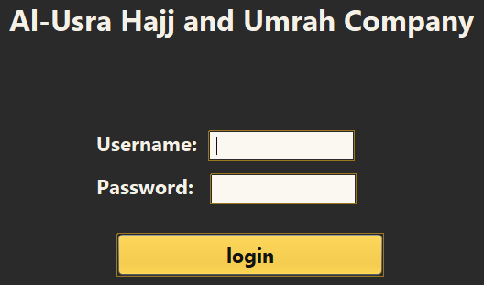
Project Overview
The Al-Usra Hajj and Umrah Company Management System is a desktop application designed to manage the main operations of a Hajj and Umrah company.
The system organizes data related to users, employees, Hajj applicants, campaigns, packages, bookings, hotels, transportation, tasks, and messages.
It uses Java Swing for the graphical user interface and MySQL for database management.

Slide 3
Problem Statement
Hajj and Umrah companies manage many types of data such as customers, employees, bookings, hotels, transportation, packages, tasks, and messages.
Managing this data manually can cause several problems:
- Data duplication
- Missing or incorrect records
- Slow searching and updating
- Difficulty tracking customer services
- Lack of access control between users

Slide 4



Project Objectives
The main objectives of this project are:
- To design a database system for a Hajj and Umrah company
- To organize company data in a structured MySQL database
- To create user-friendly Java Swing interfaces
- To provide role-based access for Manager, Employee, and Customer
- To support CRUD operations: Add, View, Update, and Delete
- To connect the Java application with the MySQL database using JDBC
Database icon
Link/Server icon
To organize company data in MySQL
JDBC connection
Java icon
Table/CRUD icon
To create Java Swing interfaces
Add, View, Update, Delete
Users icon
Role-based access
Login icon
Code icon
Security icon

Slide 5



Tools and Technologies Used
The project was developed using the following tools:
- NetBeans: used to build the Java application and design the GUI
- Java Swing: used to create forms, buttons, tables, and panels
- MySQL: used to store and organize the database
- MySQL Workbench: used to create tables, relationships, and test SQL queries
- JDBC: used to connect the Java application with the MySQL database
Database
Java
NetBeans
MySQL
Workbench

Slide 6
System Users and Roles
The system supports three main user roles:
Manager:
- Manages campaigns, Hajj applicants, employees, hotels, and transport companies
- Has full access to the main management screens
Employee:
- Views and updates profile information
- Checks assigned tasks
- Reads and replies to messages
Customer:
- Views personal Hajj information
- Checks booking, hotel, and transport details
- Can edit limited information such as phone number and password
Manager
Customer
Employee

Slide 7

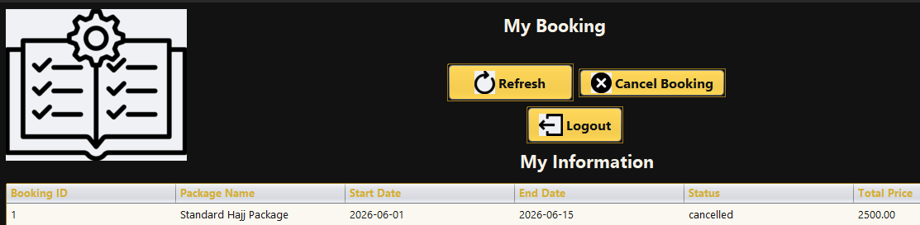
System Features
The system provides several important features:
- Role-based login
- CRUD operations
- Employee task management
- Internal messaging
- Customer booking view
- Hotel and transport tracking
- Organized dashboards

Slide 8
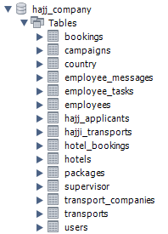
Database Overview
The system uses a MySQL relational database to store and organize all project data.
The database is divided into several related tables, such as:
- users
- employees
- hajj_applicants
- campaigns
- packages
- bookings
- hotels
- hotel_bookings
- transport_companies
- transports
- employee_tasks
- employee_messages
Each table represents a specific part of the system and is connected to other tables using primary keys and foreign keys.

Slide 9
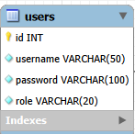

Main Database Tables
Important tables in the system:
- users: stores login accounts and roles
- employees: stores employee information
- hajj_applicants: stores pilgrim/customer data
- campaigns: stores campaign records
- packages: stores Hajj package details
- bookings: stores customer bookings
- hotels: stores hotel information
- hotel_bookings: stores hotel reservations
- transports: stores transport trips
- employee_tasks: stores employee tasks
- employee_messages: stores internal messages

Slide 10
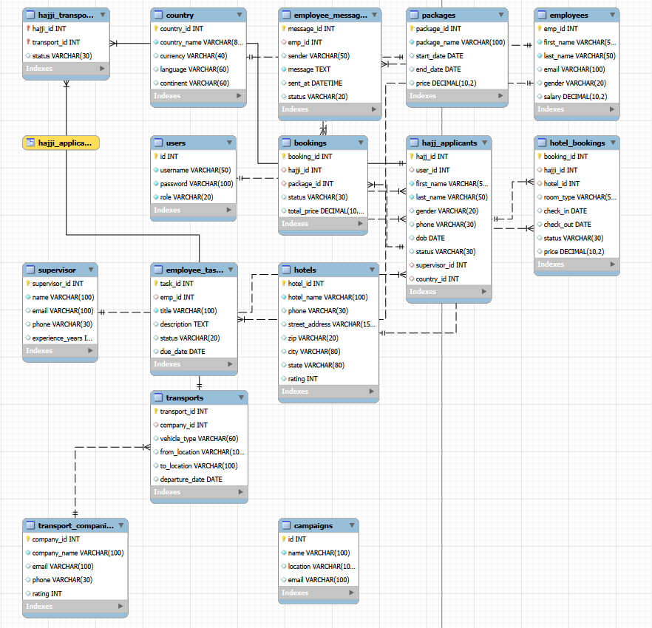
Relationships and Constraints
The database uses Primary Keys and Foreign Keys to connect tables.
Examples:
- employees → employee_tasks
- employees → employee_messages
- hajj_applicants → bookings
- packages → bookings
- hotels → hotel_bookings
- transports → hajji_transports
Constraints help protect data and prevent invalid records.

Slide 11
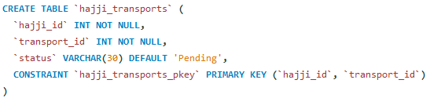
SQL Implementation
SQL was used to:
- Create database tables
- Define columns and data types
- Add primary keys and foreign keys
- Insert sample data
- Apply CRUD operations
Main SQL commands used:
CREATE TABLE, INSERT, SELECT, UPDATE, DELETE

Slide 12
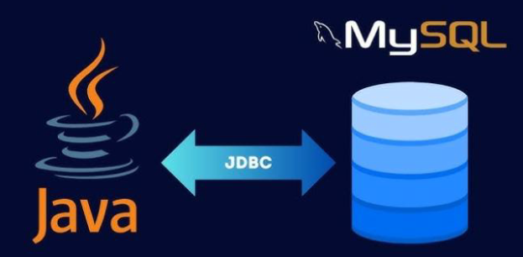
Java and JDBC Connection
The Java application connects to MySQL using JDBC.
The system uses:
- Connection: to connect Java with MySQL
- PreparedStatement: to execute SQL queries safely
- ResultSet: to retrieve query results
- JTable: to display database records in the GUI
Workflow:
Button Click → SQL Query → Database → GUI Display
Java GUI → JDBC → MySQL Database

Slide 13
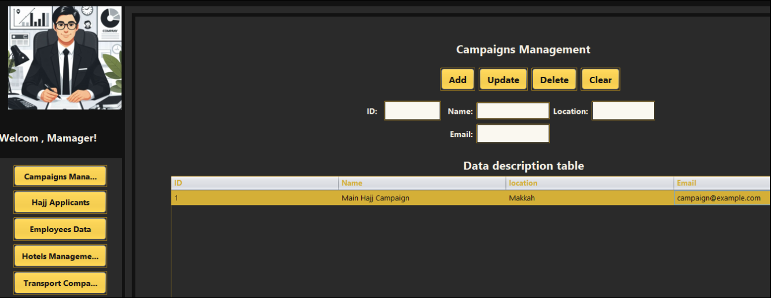
Manager Dashboard
The Manager Dashboard provides full access to management screens.
The Manager can manage:
- Campaigns
- Hajj applicants
- Employees
- Hotels
- Transport companies
The Manager can add, update, delete, and view records.

Slide 14
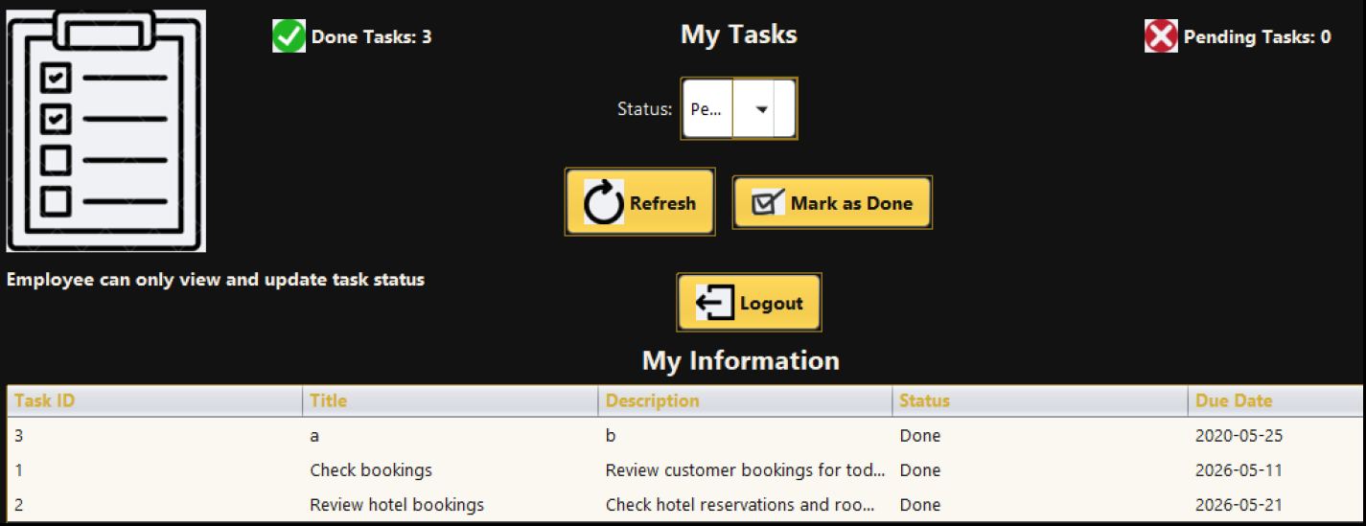
Employee Dashboard
The Employee Dashboard provides work-related services.
The Employee can:
- View profile information
- View assigned tasks
- Mark tasks as done
- Read and reply to messages
Main tables:
- employees
- employee_tasks
- employee_messages

Slide 15
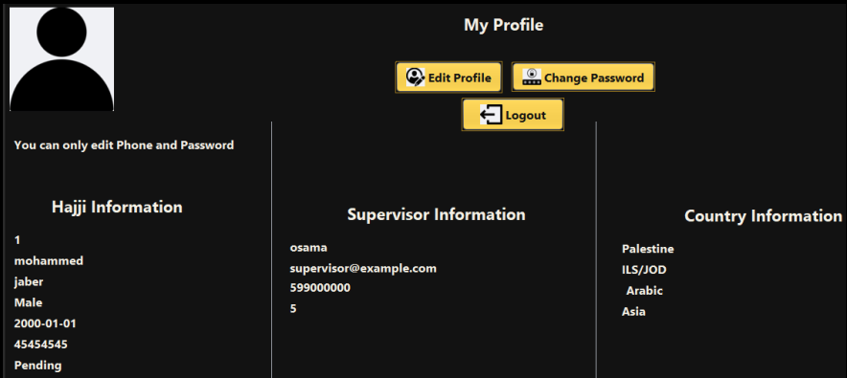
Customer Dashboard
The Customer Dashboard allows customers to view Hajj-related services.
The Customer can view:
- Personal Hajj profile
- Booking information
- Hotel reservation
- Transport information
The customer has limited access and can only view personal service data.

Slide 16

CRUD Operations
The system supports the four main database operations:
Create:
- Add new records
Read:
- Display records in tables
Update:
- Modify existing data
Delete:
- Remove records when needed
These operations are mainly used in the Manager Dashboard.

Slide 17
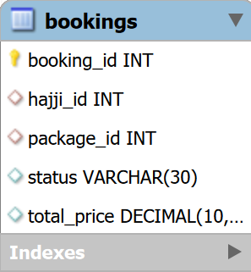

Testing and Validation
The system was tested using sample data in MySQL.
Testing included:
- Login for different roles
- Adding and updating records
- Viewing data in tables
- Updating task status
- Cancelling bookings
- Checking database changes in Workbench
Testing confirmed that the GUI is connected correctly with the database.

Slide 18
Challenges and Solutions
Main challenges:
- Connecting Java with MySQL
Solution: Using JDBC and DBConnection.java
- Displaying data for the correct user
Solution: Filtering data using emp_id and hajji_id
- Organizing many tables and relationships
Solution: Using primary keys, foreign keys, and normalization
- Keeping interfaces updated
Solution: Refresh buttons and table reload methods

Slide 19
Future Improvements
The system can be improved in the future by adding:
- Search and filtering options
- PDF report generation
- Stronger password security
- Notification system
- Better dashboard design
- More validation for user input
- More detailed reports for bookings, hotels, and transport

Slide 20
Conclusion and Project Resources
Conclusion: The system provides an organized database solution for managing a Hajj and Umrah company. It supports: - Role-based access - CRUD operations - Database relationships - Java and MySQL integration - Manager, Employee, and Customer dashboards

Slide 21
Project Resources
The project files can be accessed using the following links:
Source Code:
https://github.com/HibaMeneh/HajiiCompanySystem
Database SQL File:
https://drive.google.com/drive/folders/1SfC1LHnourozUQZdVeOvd1eFaKZ-j73z?hl=ar
Project Report:
https://drive.google.com/drive/folders/18duxPOWe-xY3yPafysyipHD4weGxBhdY?hl=ar
ERD and Normalization Document:
https://drive.google.com/drive/folders/1ctKbE_jBrty-wuRPUunhvnDcrDKsRlEY?hl=ar

